Slide 1
Unsupervised Learning

Slide 2
Unsupervised Learning
Unsupervised learning is a type of machine learning that learns from unlabeled data. This means that the data does not have any pre-existing labels or categories.
The goal of unsupervised learning is to discover patterns and relationships in the data without any explicit guidance.

Slide 3
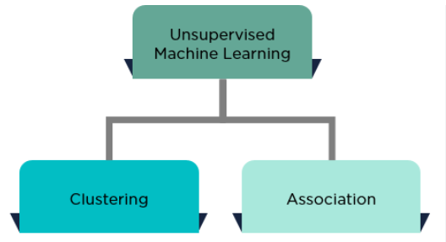
Types of Unsupervised Learning

Slide 4
Types
Clustering: A clustering problem is where you want to discover the inherent groupings in the data, such as grouping customers by purchasing behavior.
Association: An association rule learning problem is where you want to discover rules that describe large portions of your data, such as people that buy X also tend to buy Y.

Slide 5
Clustering
Hierarchical clustering
K-means clustering
Principal Component Analysis
Singular Value Decomposition
Independent Component Analysis
Gaussian Mixture Models (GMMs)
Density-Based Spatial Clustering of Applications with Noise (DBSCAN)

Slide 6
Association rule learning
Apriori Algorithm
Eclat Algorithm
FP-Growth Algorithm

Slide 7
K-means Clustering
K means clustering, assigns data points to one of the K clusters depending on their distance from the center of the clusters.
It starts by randomly assigning the centroid of the cluster in the space. Then each data point is assigned to one of the clusters based on its distance from the centroid of the cluster.

Slide 8
K-Means Clustering is an Unsupervised Learning algorithm, which groups the unlabeled dataset into different clusters.
Here K defines the number of pre-defined clusters that need to be created in the process
It allows us to cluster the data into different groups and a convenient way to discover the categories of groups in the unlabeled dataset on its own without the need for any training.

Slide 9
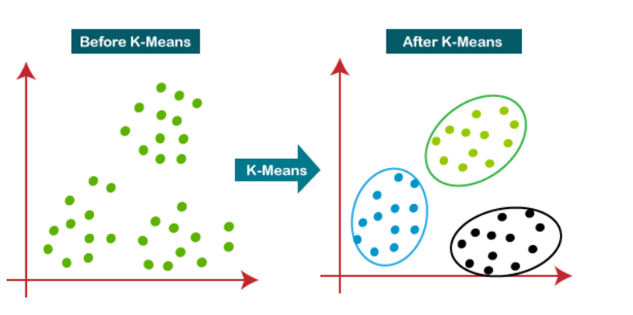

Slide 10
It is a centroid-based algorithm, where each cluster is associated with a centroid. The main aim of this algorithm is to minimize the sum of distances between the data point and their corresponding clusters.
The algorithm takes the unlabeled dataset as input, divides the dataset into k-number of clusters, and repeats the process until it does not find the best clusters.

Slide 11
Properties of Clusters
All the data points in a cluster should be similar to each other.
The data points from different clusters should be as different as possible.

Slide 12
Application of Clustering
Customer Segmentation
Document clustering
Image segmentation

Slide 13
Dunn Index
Inertia actually calculates the sum of distances of all the points within a cluster from the centroid of that cluster.
if the distance between the centroid of a cluster and the points in that cluster is small, it means that the points are closer to each other. So, inertia makes sure that the first property of clusters is satisfied. But it does not care about the second property – that different clusters should be as different from each other as possible.
This is where the Dunn index comes into action.

Slide 14
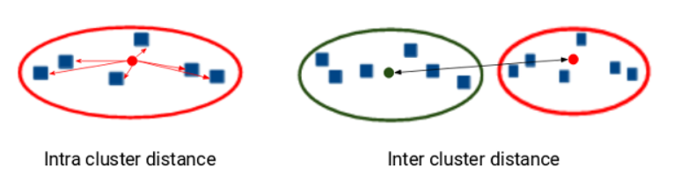
Along with the distance between the centroid and points, the Dunn index also takes into account the distance between two clusters. This distance between the centroids of two different clusters is known as inter-cluster distance.

Slide 15
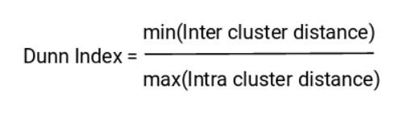
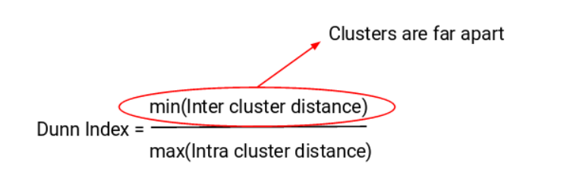

Slide 16
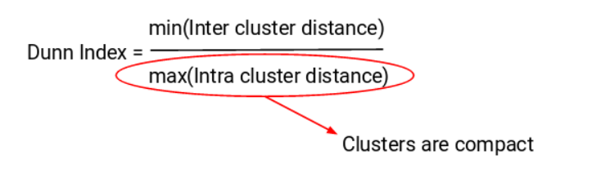

Slide 17
Hierarchical Clustering
Hierarchical clustering is another unsupervised machine learning algorithm, which is used to group the unlabeled datasets into a cluster and also known as hierarchical cluster analysis or HCA.
In this algorithm, we develop the hierarchy of clusters in the form of a tree, and this tree-shaped structure is known as the dendrogram.

Slide 18
The hierarchical clustering technique has two approaches.
Agglomerative
Divisive

Slide 19
Agglomerative
Agglomerative is a bottom-up approach, in which the algorithm starts with taking all data points as single clusters and merging them until one cluster is left.
Divisive algorithm is the reverse of the agglomerative algorithm as it is a top-down approach.

Slide 20
Agglomerative Hierarchical clustering
It means, this algorithm considers each dataset as a single cluster at the beginning, and then start combining the closest pair of clusters. It does this until all the clusters are merged into a single cluster that contains all the datasets.

Slide 21
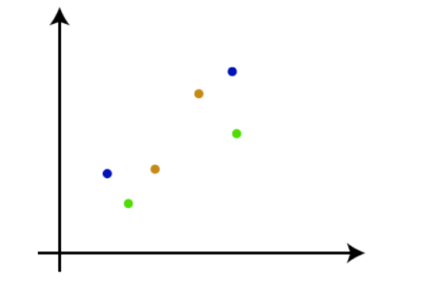
Step-1: Create each data point as a single cluster. Let's say there are N data points, so the number of clusters will also be N.

Slide 22
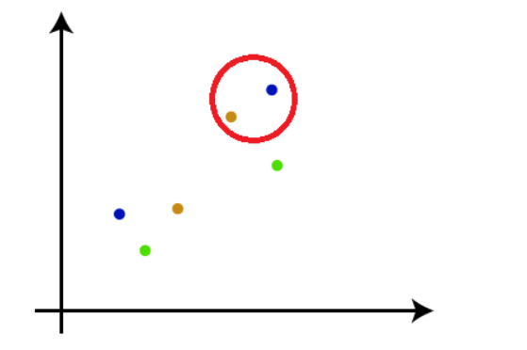
Step-2: Take two closest data points or clusters and merge them to form one cluster. So, there will now be N-1 clusters.

Slide 23
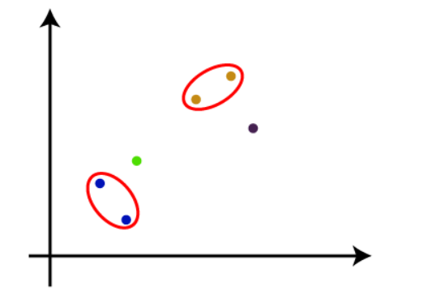
Step-3: Again, take the two closest clusters and merge them together to form one cluster. There will be N-2 clusters.

Slide 24
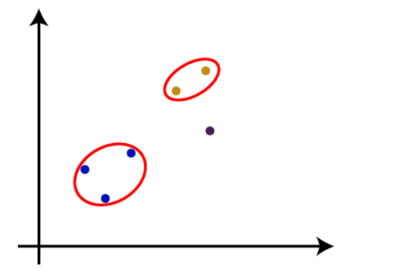
Step-4: Repeat Step 3 until only one cluster left. So, we will get the following clusters. Consider the below images:

Slide 25
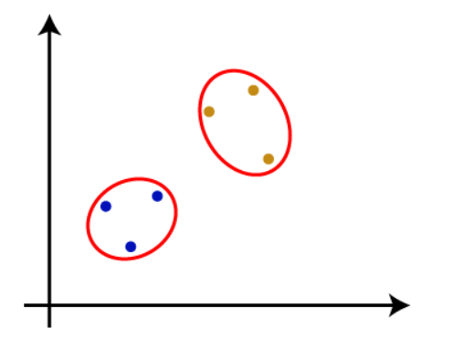

Slide 26
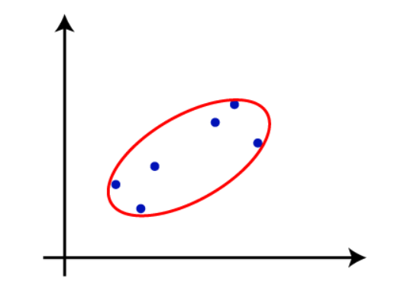

Slide 27
Step-5: Once all the clusters are combined into one big cluster, develop the dendrogram to divide the clusters as per the problem.

Slide 28
The dendrogram is a tree-like structure that is mainly used to store each step as a memory that the HC algorithm performs.
In the dendrogram plot, the Y-axis shows the Euclidean distances between the data points, and the x-axis shows all the data points of the given dataset.

Slide 29
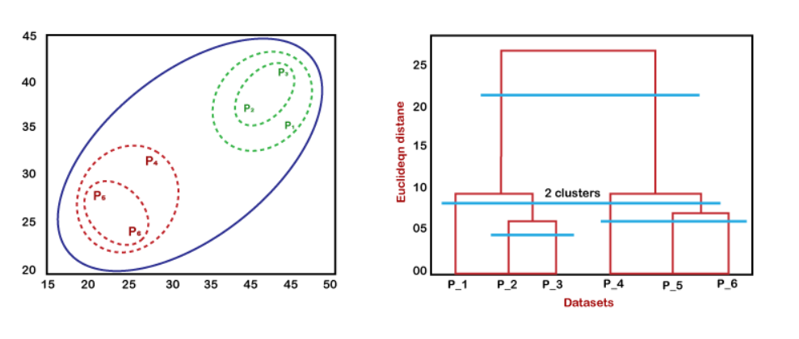

Slide 30
Probabilistic Clustering
Probabilistic clustering is a type of clustering algorithm that assigns data points to clusters based on the probability that they belong to each cluster.
Probabilistic hierarchical clustering is a machine-learning technique that groups similar data points into clusters. This method assigns probabilities to the likelihood of a point belonging to each cluster.

Slide 31
The Gaussian Mixture Model or GMM is defined as a mixture model that has a combination of the unspecified probability distribution function.

Slide 32
Gaussian mixture models (GMMs)
Gaussian mixture models (GMMs) are a type of machine learning algorithm. They are used to classify data into different categories based on the probability distribution.
GMM also requires estimated statistics values such as mean and standard deviation or parameters.
It is used to estimate the parameters of the probability distributions to best fit the density of a given training dataset.
there are plenty of techniques available to estimate the parameter of the Gaussian Mixture Model (GMM), the Maximum Likelihood Estimation is one of the most popular techniques among them.

Slide 33
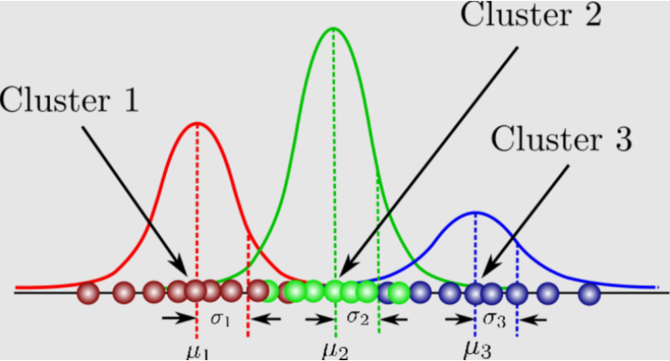

Slide 34
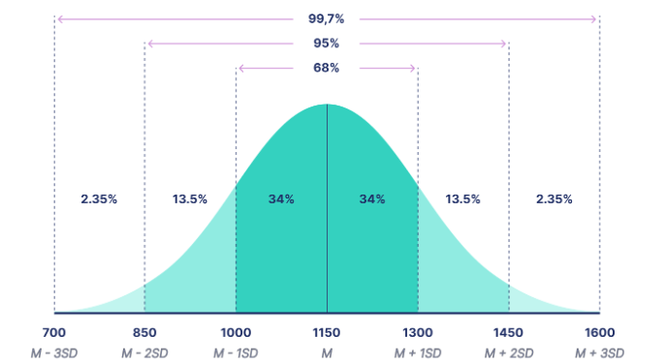

Slide 35
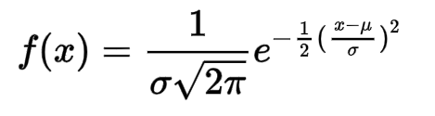
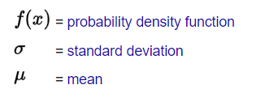

Slide 36
Estimation-Maximization algorithm is one of the best techniques which helps us to estimate the parameters of the gaussian distributions.
In the EM algorithm, E-step estimates the expected value for each latent variable, whereas M-step helps in optimizing them significantly using the Maximum Likelihood Estimation (MLE).
Further, this process is repeated until a good set of latent values, and a maximum likelihood is achieved that fits the data.

Slide 37
Advantages of EM algorithm
It is very easy to implement the first two basic steps of the EM algorithm in various machine learning problems, which are E-step and M- step.
It is mostly guaranteed that likelihood will enhance after each iteration.
It often generates a solution for the M-step in the closed form.

Slide 38
Disadvantages of EM algorithm
The convergence of the EM algorithm is very slow.
It can make convergence for the local optima only.
It takes both forward and backward probability into consideration. It is opposite to that of numerical optimization, which takes only forward probabilities.

Slide 39
Association Rule Learning
Association rule mining finds interesting associations and relationships among large sets of data items.
This rule shows how frequently an itemset occurs in a transaction.
A typical example is a Market-Based Analysis. Market-Based Analysis is one of the key techniques used by large relations to show associations between items.
Example: Bread, Milk

Slide 40
Apriori Algorithm
Apriori algorithm refers to the algorithm that is used to calculate the association rules between objects. It means how two or more objects are related to one another.
We can also say that the apriori algorithm is an association rule learning that analyzes that people who bought product A also bought product B.
Generally, you operate the Apriori algorithm on a database that consists of a huge number of transactions.

Slide 41
What is Apriori Algorithm?
Apriori algorithm refers to an algorithm that is used in mining frequent products sets and relevant association rules.
Generally, the apriori algorithm operates on a database containing a huge number of transactions. For example, the items customers buy at a Big Bazar.
Apriori algorithm helps the customers to buy their products with ease and increases the sales performance of the particular store.

Slide 42
Components of Apriori algorithm
The given three components comprise the apriori algorithm.
Support
Confidence
Lift

Slide 43
Example
Suppose you have 4000 customer transactions in a Big Bazar. You have to calculate the Support, Confidence, and Lift for two products, and you may say Biscuits and Chocolate. This is because customers frequently buy these two items together.
Out of 4000 transactions, 400 contain Biscuits, whereas 600 contain Chocolate, and these 600 transactions include a 200 that includes Biscuits and chocolates. Using this data, we will find out the support, confidence, and lift.

Slide 44
Support
Support refers to the default popularity of any product. You find the support as a quotient of the division of the number of transactions comprising that product by the total number of transactions.
Support (Biscuits) = (Transactions relating biscuits) / (Total transactions)
Support (Biscuits) = 400/ 4000 = 10 %

Slide 45
Confidence
Confidence refers to the possibility that the customers bought both biscuits and chocolates together. So, you need to divide the number of transactions that comprise both biscuits and chocolates by the total number of transactions to get the confidence.
Confidence = (Transactions relating both biscuits and Chocolate) / (Total transactions involving Biscuits)
Confidence = 200/400 = 50%
It means that 50 percent of customers who bought biscuits bought chocolates also.

Slide 46
Lift
Lift refers to the increase in the ratio of the sale of chocolates when you sell biscuits. The mathematical equations of lift are given below.
Lift = (Confidence (Biscuits - chocolates)/ (Support (Biscuits)
Lift = Confidence/ Support
Lift = 50 /10 = 5

Slide 47
Conclusion
It means that the probability of people buying both biscuits and chocolates together is five times more than that of purchasing the biscuits alone.
If the lift value is below one, it means that the people are unlikely to buy both the items together.
The Larger the value, the better is the combination.

Slide 48
Advantages of Apriori Algorithm
It is used to calculate large itemsets.
Simple to understand and apply.

Slide 49
Disadvantages of Apriori Algorithms
Apriori algorithm is an expensive method to find support since the calculation has to pass through the whole database.

Slide 50
FP Growth Algorithm
The FP Growth algorithm in data mining is a popular method for frequent pattern mining.
The algorithm is efficient for mining frequent item sets in large datasets. It works by constructing a frequent pattern tree (FP-tree) from the input dataset.

Slide 51
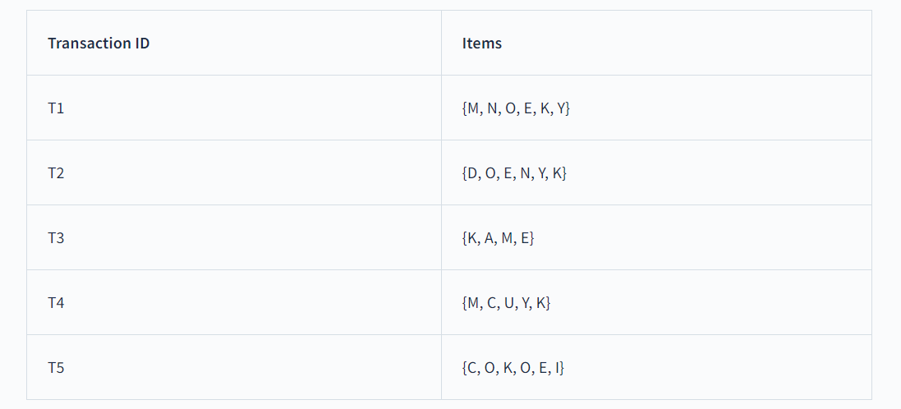
Algorithm by Han

Slide 52
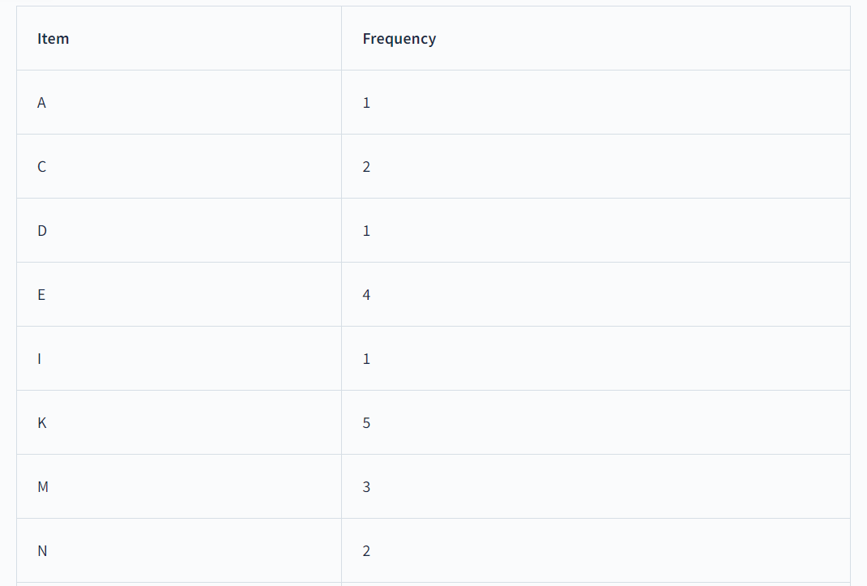
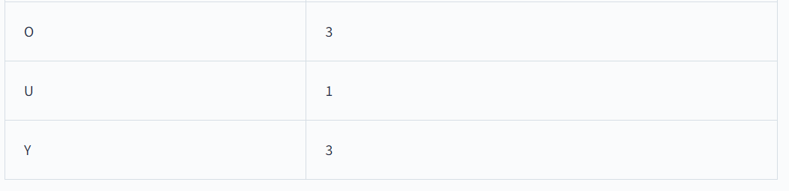
Let’s scan the database and compute the frequency of each item as shown in the below table.

Slide 53
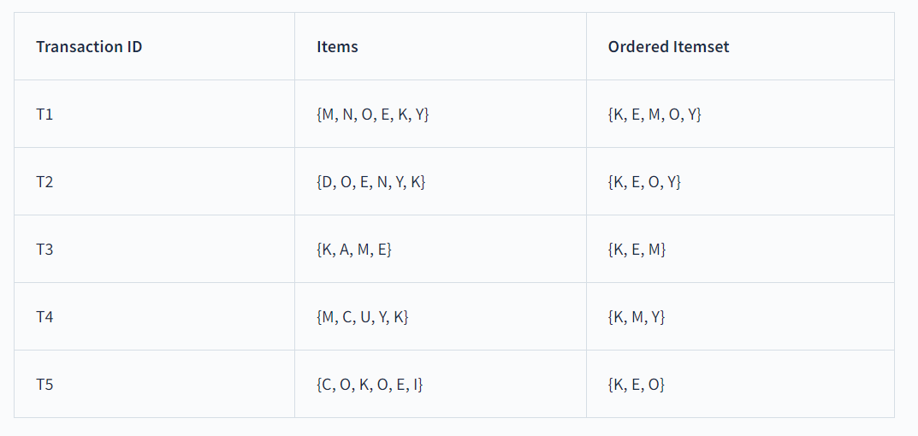
Let’s consider minimum support as 3. After removing all the items below minimum support in the above table, we would remain with these items - {K: 5, E: 4, M : 3, O : 3, Y : 3}. Let’s re-order the transaction database based on the items above minimum support. In this step, in each transaction, we will remove infrequent items and re-order them in the descending order of their frequency, as shown in the table below.

Slide 54
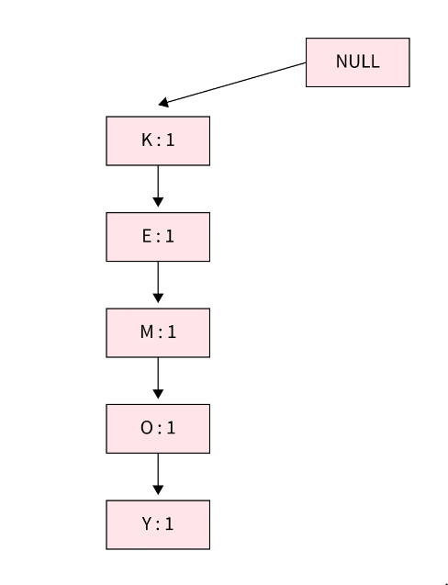
First Transaction {K, E, M, O, Y}:
In this transaction, all items are simply linked, and their support count is initialized as 1.

Slide 55
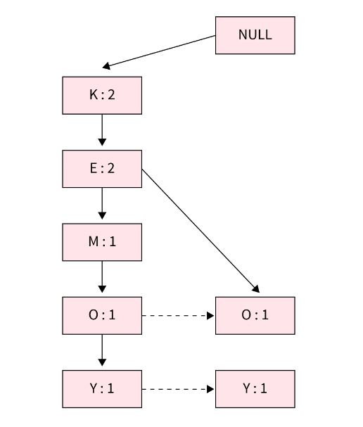
Second Transaction {K, E, O, Y}:
In this transaction, we will increase the support count of K and E in the tree to 2. As no direct link is available from E to O, we will insert a new path for O and Y and initialize their support count as 1.

Slide 56
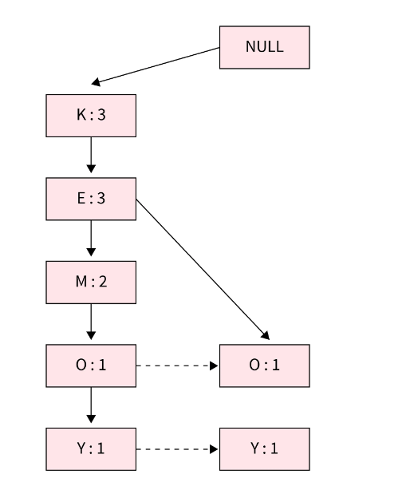
Third Transaction {K, E, M}:
After inserting this transaction, the tree will look as shown below. We will increase the support count for K and E to 3 and for M to 2.

Slide 57
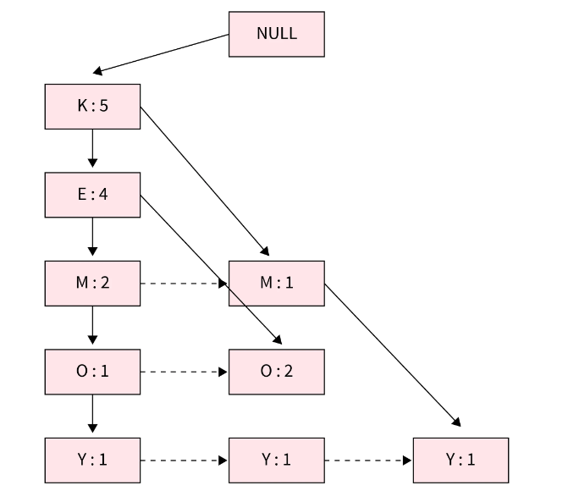
Fourth Transaction {K, M, Y} and Fifth Transaction {K, E, O}:

Slide 58
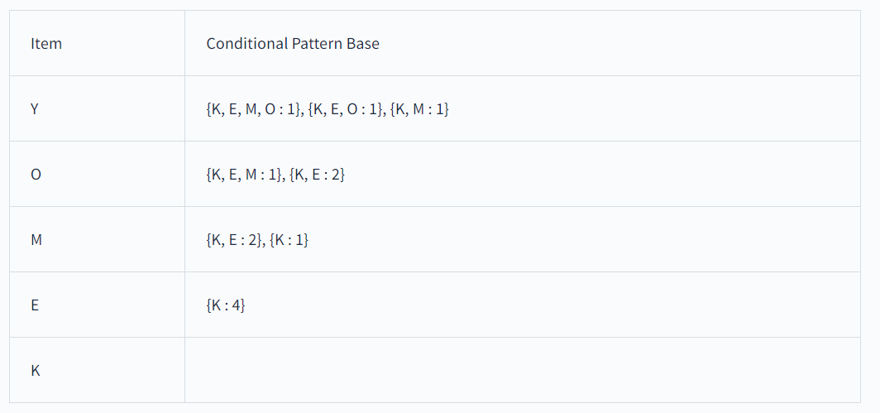

Slide 59
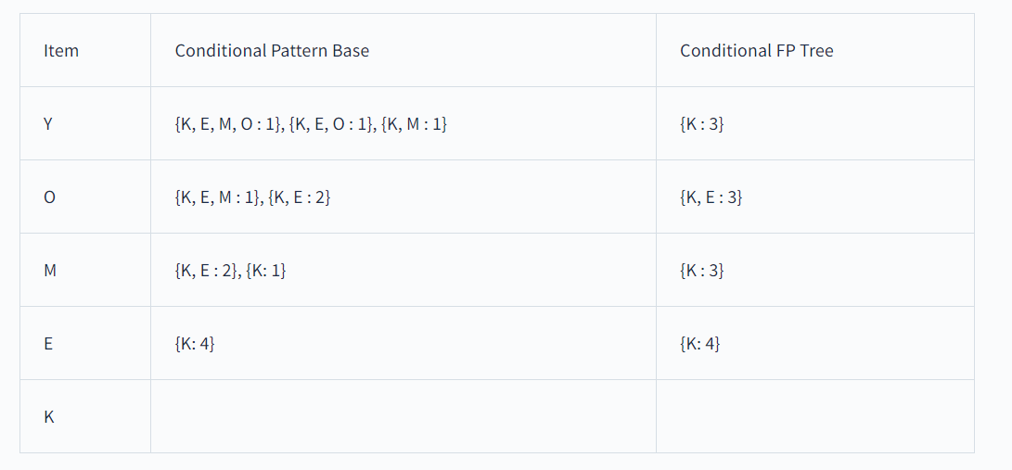

Slide 60
